Slide 1
Welcome to our January 10 minute meeting

Slide 2
REMINDER: January 26th
January 26th: it's a non-work, non-paid day off for certificated staff (basically it's akin to a Saturday). You can do whatever you want on that day, including sleep in!
January 26th for ESPs: ESPs (except for 9 and 9.5 month ESPs) have January 26th as a paid work day. (Some may want to use comp time or wellness)
Certificated staff: reminder that we negotiated an additional 7.5 hours of pay that recognize January

Slide 3
Digital 1:1s
FWEA will continue to hold Digital 1:1s throughout the month of January!
All sessions will be held via Zoom and are 10 minutes long!
Members may use professional time, lunch or planning for these important conversations!

Slide 4
Remaining Listening Session Dates:
In addition to our listening session day on January 16th, we are offering sign-ups for the following days:
January 23rd
January 24th
January 30th

Slide 5
Grab your phone and sign up now!
Need help with troubleshooting? Ask a colleague! If you still need help, please call the FWEA office for additional support at 253-838-8571!

Slide 6
WEA Representative Assembly Nominations are now closed! We will hold elections February 2 -12.

Slide 7
NEA-RA Nominations
The NEA-RA will be held July 3-July 7 in Philadelphia PA
Email Tiafwea@aol.com
Flight, hotel and meal stipend are paid by FWEA for this important work
Nominations will close at the March 18th AR Meeting. Elections will run March 25th-March 29th

Slide 8
Executive Board Nominations
The following positions of the FWEA Executive Board are up for re-election this spring. All positions are for 2 (two) year terms. We will be opening nominations for the following positions:
President
Vice President
Secretary
High School Representative
ESP Representative
Ethnic Minority Representative
Elementary Representative
Nominations open on January 22nd and close on March 18th

Slide 9
Teri Packard Scholarship
FWEA members who have children graduating:
Members can email Tiafwea@aol.com for the application and questions
Applications are due by April 15th

Slide 10
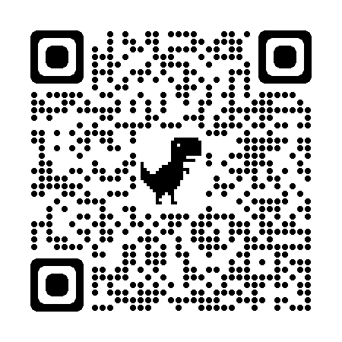
Upcoming Event
BLM at School week is February 5 -9
FWEA is hosting an Open House to support the week on February 1st from 4:30 – 6:00 PM – sign up on the next slide!
Can’t make the event but still want to participate?
Scan this QR code for all the resources:

Slide 11
BLM at School Week– join with FWEA members to prepare for it on February 1st!
Scan the QR code to sign up for our Open House on February 1st from 4:30 – 6:00 PM to support BLM week!
Pizza, printed materials, informal conversation with colleagues, and a free BLM t-shirt for later in February!

