Slide 1
Welcome to our October 10 minute meeting

Slide 2
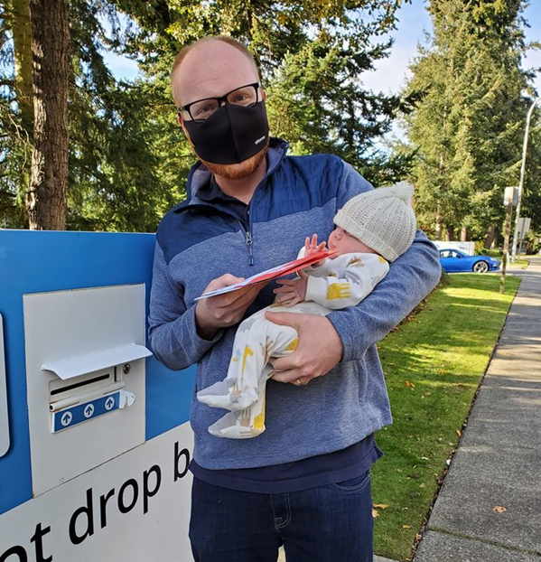
This November 7 election: School Board Candidates in Federal Way!
Ballots will be mailed on October 18 – should be received by October 21st.
Vote early and encourage all your friends and neighbors to vote pro-public education! You can access recommendations by googling “WEA PAC 2023 Endorsements”
The makeup of our school board DIRECTLY impacts our work, and our negotiations in the Bargain

Slide 3
Shared Decision Making
Shared Decision Making is a process which is called out throughout our CBA
Decisions which should be made using the Shared Decision Making Model include:
Site Equity Leadership Team
Professional Time adjustments
Supervision,
Monthly Staff Meetings and more….

Slide 4
Reminder: Student Led Conferences
In person format with option for zoom if a family prefers this format
The schedule of which nights is a shared decision
CBA includes 14 hours to schedule (minus planning = many have 12 hours to fit the SLCs into)
Adjust length of conferences to fit within the 14 hours (ex: elementary class sizes are large and will not be able to have 30 min conferences)
ESPs must be compensated for any additional work past their scheduled day
New teachers are not trained on SLCs. Please keep an eye out, and help them avoid overscheduling themselves!

Slide 5
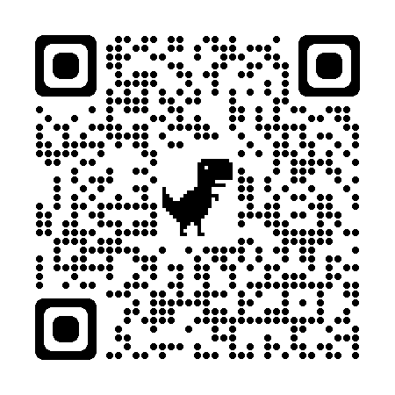
FWEA Member Grants now open!
60 grants for both ESP and Certificated staff members of up to $75
The grants are for supplies, materials, or activities in support of your current assignment and students beyond basic curriculum needs (which is FWPS responsibility)
The grant application is on our website: http://www.federalwayea.org/. Or scan the QR code.
Grant applications are due by December 22, 2023. Grant applications should be submitted electronically to tiafwea@aol.com

Slide 6
WEA Representative Assembly Nominations are open
The 2024 WEA RA will be April 11-13 in Spokane, WA
Be the voice of FWEA members, students and community setting state level policy, with 1,000 other educator-leaders!
Nominations are open now through the January AR meeting. The election will be open February 2 – 12.
Please email tiafwea@aol.com and title the email “Nomination”

Slide 7
Upcoming Events:
Homebuyers Seminar: October 19th 5:00-6:30
Ballots arrive: October 21st
Luckisha Phillips sign waving:
10/28 at 9 AM @ Pac Hwy & 320th (costumes encouraged!!)
11/4 at 9 AM @ Pac Hwy & 320th
ESP Dinner: November 1st 4:45-6:15 – we will be sending email reminders too.
Ballots due: NOVEMBER 7TH

Slide 8
Discussion! ARs meet monthly with admin and also work with Executive Board on hot topics. It’s important voices are in the room, so what is bubbling up?

