Slide 1
September FWEA 10-minute meeting
9.19.2023

Slide 2
Why are we here?
The FWEA ten-minute meeting is a way for us to stay connected to our union.
We use this time to update our members on issues that might be bubbling up…
…..and keep them informed on opportunities for solidarity and growing our collective power.
We are stronger together!

Slide 3
Professional Time – what is it?
Let’s take a moment to read our language about professional time on pg. 46:
Professional Time: since staff members often need to meet with students beyond the student day, communicate with parents regarding student progress (particularly those who are struggling to progress), plan quality instruction, and collaborate with colleagues, the approximately thirty minutes before and after the student day (previously called WAC time, now called “Professional Time”) is a resource for addressing these responsibilities. This time does not count toward a staff member’s 180 hours of planning time unless otherwise determined through the shared decision making process. If time is bundled in chunks larger than thirty minutes, it needs only add up to a total of five hours per week. The use of this time is intended to be flexible

Slide 4
Professional Time…a deeper dive.
So what does this mean in practice….
During my professional time, can I be required to supervise arrival/dismissal activities?
You must assist with student dismissal, but supervision should not encroach significantly on your professional time. At elementary, supervision includes: walking students to and from lunch, specialist time and recess, to bus and/or parent pickup. At secondary, supervision includes standing at doors and/or monitoring common areas during passing times and dismissal.
When does professional time happen on early release days?
Earlier this year, communication was sent by Diane Ellis. Early release activities (Building/District PD, PLC’s and Common Planning) should occur as soon as students depart, and the end time on an Early Release Day is the same as any other day of the week. The 75 minutes is inclusive of transition time.

Slide 5
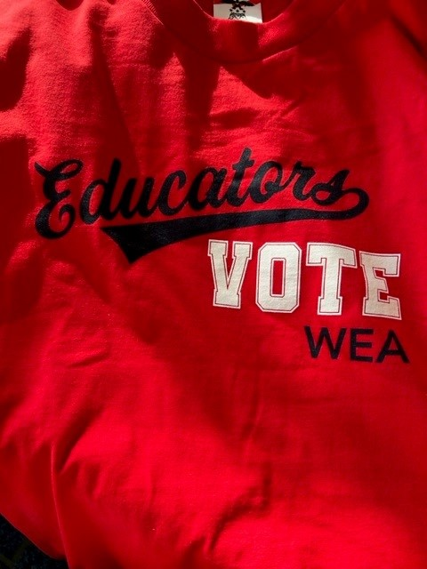
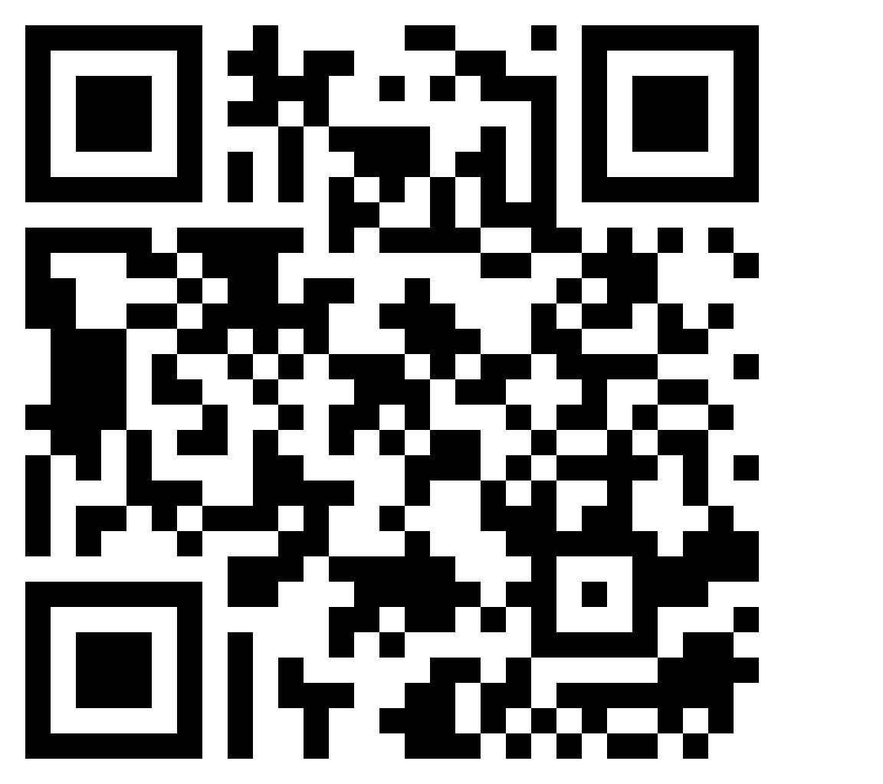
Supporting our School Board Candidates
Luckisha Phillips has asked for support with sign waving!
10/28 at 9 AM @ Pac Hwy & 320th (costumes encouraged!!)
11/4 at 9 AM @ Pac Hwy & 320th
What else are YOU willing to do? Let us know!
We ask that you place a tentative “hold” on Saturdays in October.
Scan the QR code to the right and add your name to this google form so we can reach out directly as more campaigning opportunities arise.

Slide 6
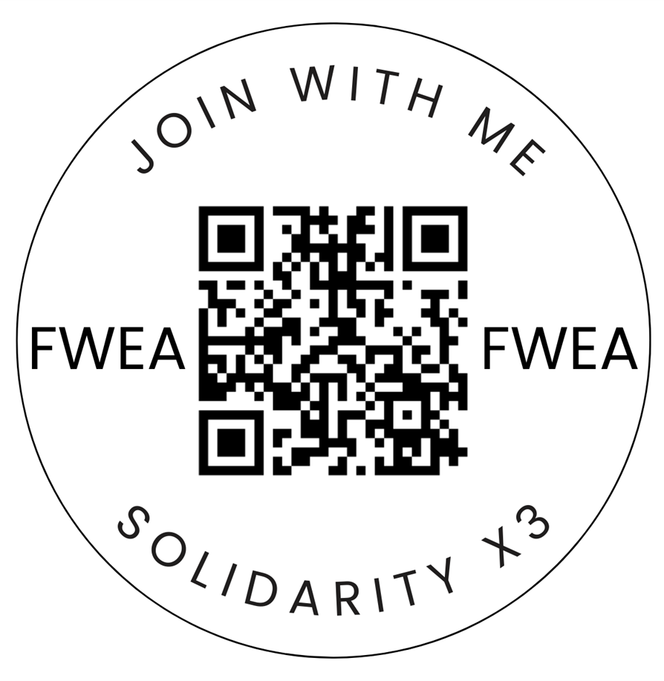
A week in review: Solidarity Week!
First off, a HUGE THANK YOU to our ARs for helping to facilitate our FIRST ever FWEA Solidarity Week! We had 345 responses!!
Here are the response rates for our solidarity statements:
I stand in solidarity with FWEA – 99% Yes!
I stand in solidarity with Student Support Services – 99% Yes!
I stand in solidarity with equity and inclusion – 98% Yes!
We want more responses! So if you didn’t participate…..
It isn’t too late – scan the code and fill it out!

Slide 7
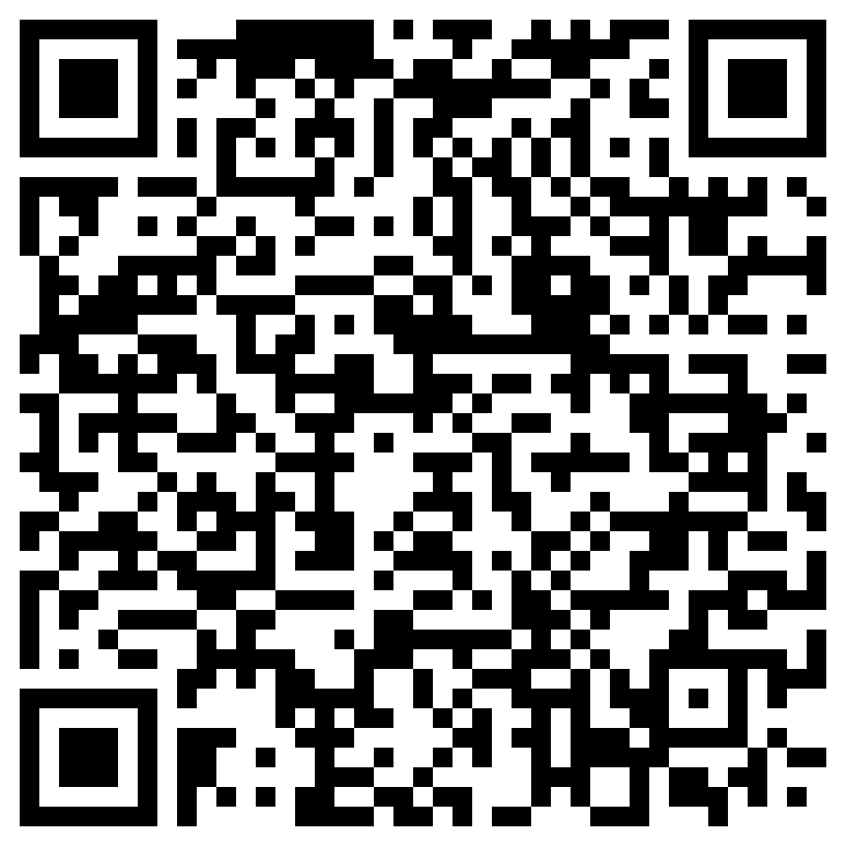
ESP and Cert Solidarity Moment!
We have a unique opportunity in October to show our amazing ESPs some love!
Friday October 13th is a non-workday for certificated staff…
……….….BUT, our ESPs will be coming together that day for a district-wide staff retreat.
So where do we come in?
We want to show our ESPs how much they mean to us as they enter their training
Bring pom-poms, signs, and most importantly yourself!
FWEA will provide everything else you need!
Won’t you join us the mornin of October 13, Certificated Staff? Scan the QR code and RSVP!

Slide 8
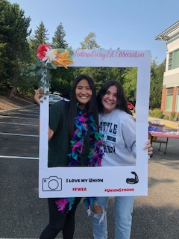
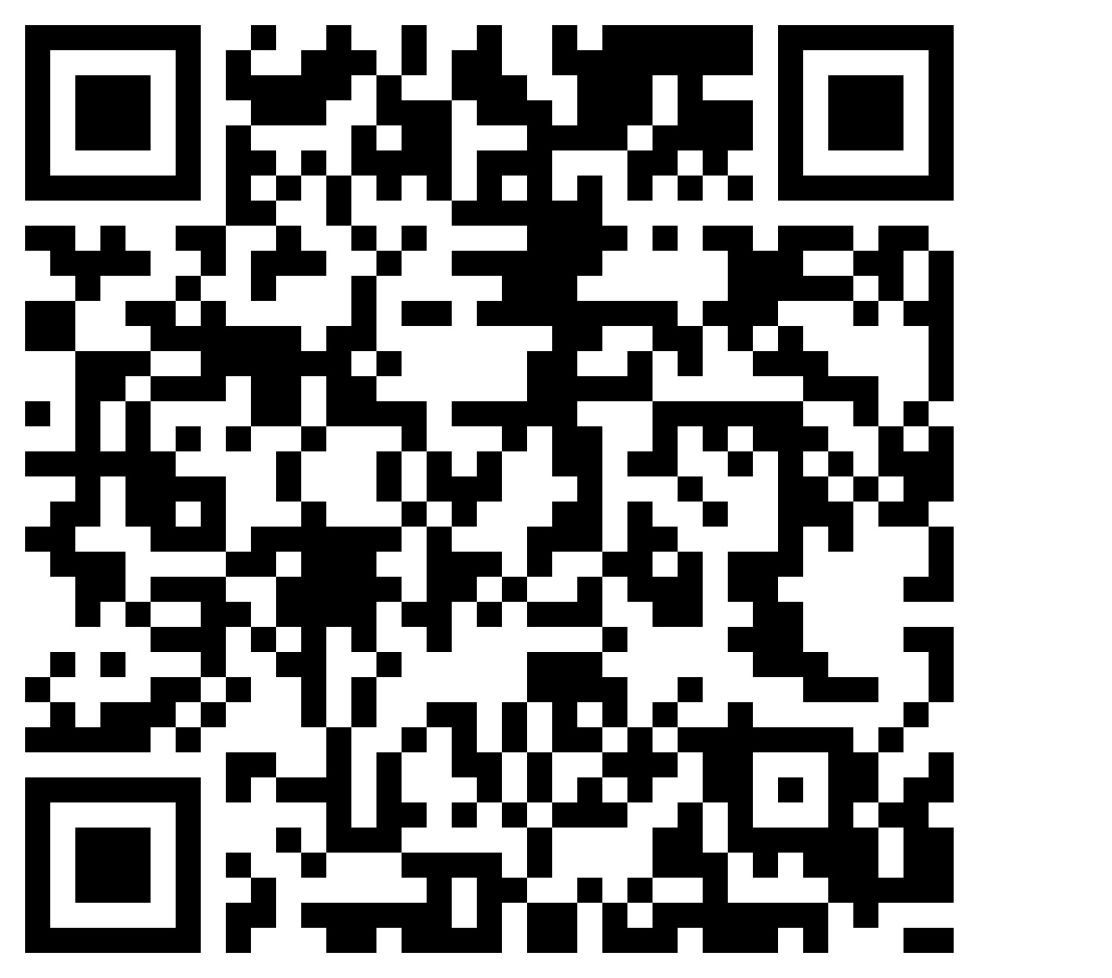
Review - Upcoming Events!
September 28th: New Member Dinner
October 13th: ESP Solidarity Day
October 19th: FWEA Home Buying Seminar
October 28th: Sign waving for Luckisha Phillips
November 4th: Sign waving for Luckisha Phillips
Use this QR code to register for all of these!

