Slide 1
Substitute Shortage
FWEA’s response to member concerns

Slide 2
Timeline
FWEA Leadership created a survey that was sent out to every guest teacher (substitute) we have on file for FWPS.
FWEA Leadership put together a committee comprised of members, guest teachers and administration to have open dialog around the ongoing issue of coverage/guest teacher shortage.
The committee met for nearly 4 hours where they:
Identified what they perceived to be the problem.
Analyzed the survey data as well as data collected from human resources.
Reviewed the groups perceptions to see if those perceptions had changed.

Slide 3
FWEA leadership shared information with FWEA Association Representatives (1-26-15).

Slide 4
The committee discussed some factors that we thought may be contributing to the issue both locally and statewide:
Mobility: In past years when the economy was down, positions were hard to come by so people were willing to take substitute positions where they had to commute. When the economy improved, jobs became more readily available closer to home.
Flexibility: Substitute teachers like the flexibility that comes with being a guest teacher. Which means they may also like the flexibility of not working Monday’s or Friday’s.
Teacher shortage: We are in the midst of a nationwide teacher shortage. As such, it is believed that many substitute teachers may have taken full time employment in education with so many openings available.
Salary and benefits: Perhaps substitute teachers are getting paid higher salaries, benefits, incentives in other districts or professions.

Slide 5
State Laws: Washington makes it difficult for retired teachers to sub.
Wellness abuse: While there are extenuating circumstances, some of our members do not use wellness leave appropriately (ie. taking only Mondays and Fridays off repeatedly, taking annual vacations mid-year, etc.
Human Resources/Hiring Practices: Do we as a district turn away potential applicants?
Substitutes cancelling last minute to take “better positions.”
Lesson Plans: Lack of quality lesson plans or no lesson plans at all.
Substitute Rotation Plans: Lack of or quality plan.
School(s) Reputation

Slide 6
Survey Says!
FWEA leadership sent out nearly 300 surveys and received an approximately 70% response rate! Of those responses, the survey says!

Slide 7
The following information was taken directly from our guest teacher surveys that we received and reviewed as a committee. As this was an anonymous survey, these are “blanket statements” that may reflect one school, many schools or no schools at all.

Slide 8
What are the top reasons substitutes said they would not take a job in all or some of Federal Way schools?
#1-Lack of support with student discipline
No behavior plan, or not followed through on.
“If the class/student is misbehaving, it must be my fault and I’m blamed for not having good management.”
Lack of support from administration.
Lack of support from colleagues in building.
Lack of respect in general from students.
#2-The way I’m treated/lack of respect
Nobody gives me the time of day
Treated poorly when I first enter the office
“I want to be where I’m wanted.”

Slide 9
#3-Poorly written sub plans and/or no sub plans provided
#4-Being given a different assignment than what was accepted
“I took a 2nd grade position, I showed up early to get ready, read the teacher’s lesson plans, made sure I had the necessary materials…only to be told two minutes before school started that they need me to teach functional core/sped instead. I will never come back to this school.”

Slide 10
So what did we learn?
It’s the legislature’s fault
It’s human resources fault
It’s the student’s fault
It’s the staff’s fault
It’s the parent’s fault
It’s the principal’s fault
It’s the site’s fault
It’s the economy’s fault

Slide 11
We also learned that:
Guest teachers like coming to FWPS!
We learned that many of our members write great lesson plans, offer tons of support and work to insure guest teachers want to come back!
That many sites have awesome site discipline plans!
That many sites have tremendous administrative support!
That FWPS works diligently to insure we have guest teachers!
That FWPS has great kids!

Slide 12
…..and most importantly, we learned that…..

Slide 13
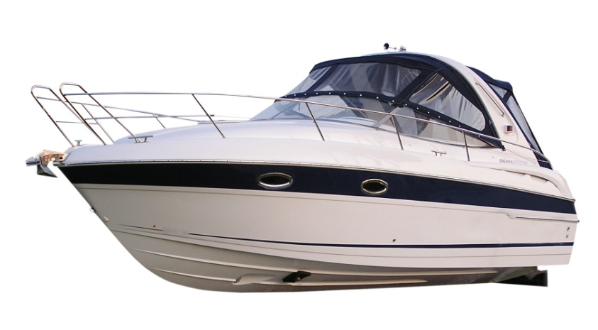
EVERY district is in the same boat!
Auburn
Federal Way
Seattle
So how do we make Federal just a bit more attractive so substitutes will get into our boat?
All WA Schools!

Slide 14
Possible ideas/strategies for individual sites:
Illahee provides a Keurig just for substitutes with a note that says “Thank You for being a guest teacher.”
Simply saying “hi”.
Take turns being a “buddy teacher” to the guest teachers on a given day (establish a rotation).
Principal dropping into to say a quick “hi” and introducing the sub to the students first thing in the morning for a particular class.
Office manager giving a key and/or personally showing sub where the classroom is.
Well written sub plans.

Slide 15
Good emergency sub plans.
Welcome guest teachers and name them during morning announcements.
Making sure guest teachers have support with discipline (well designed site discipline plan).
Providing a means for guest teachers to provide feedback to the site.
Giving guest teachers a code for the copy machine so they have the ability to make copies.
Have a designated parking spot for guest teachers.
Give every guest teacher a copy of the site’s discipline policy, a map of the school, earthquake and fire drill instructions, etc.
Etc…think outside the box! ☺

Slide 16
Possible district level solutions…TBD!
FWEA leadership will meet regularly with district management to discuss solutions above and beyond “building level ideas”. These may include changes in practices, increased compensation, etc. These would be solutions that need to be negotiated, approved, discussed, etc.

Slide 17
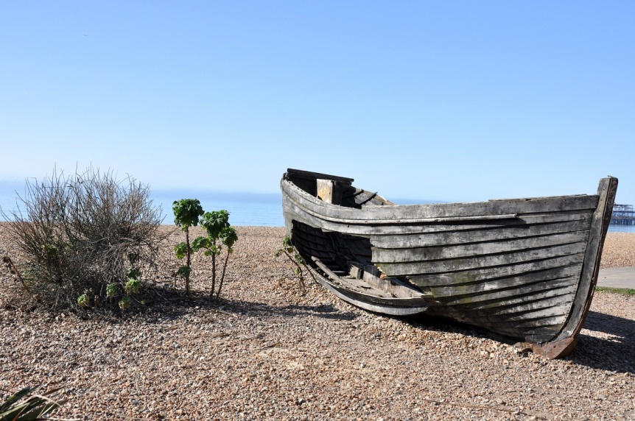
This issue isn’t going away, and it is only going to get worse
Bottom line is that we must all work to make our district, schools and individual classrooms more attractive to subs. Guest teachers have a lot of “boats” to choose from and we must make ours have better amenities than the surrounding districts.

Slide 18
Next steps…
FWPS Human Resources Director has requested an ongoing “substitute advisory committee” that will meet regularly throughout the school year.
ARs, will share data with their members and administrators.
FWEA leadership will be sending a follow up letter to all of our substitutes on file to thank them for their participation and to let them know what next steps are.

