Slide 1
CEL 5D Instructional Framework & Evaluation Process
FWEA and FWPS
Joint Evaluation Training
September, 2020
Notes:
(This PPT is designed to be presented jointly by the school administrator(s) and 1-2 FWEA member(s) such as instructional coach and FWEA building representative)
(Presenters introduce themselves)
SCRIPT:
“Hi everyone, we’re going to spend time reviewing the CEL 5D Instructional Framework, the evaluation process for certificated staff and the updated evaluation negotiation agreements.”

Slide 2
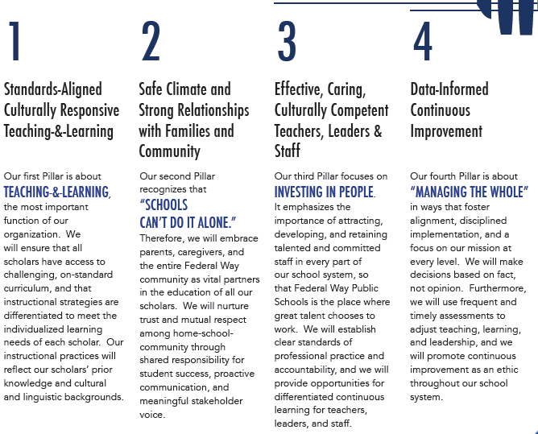

  Our Pillars
  Capabilities we must develop to nurture effective instruction and a mission-focused empowering organizational infrastructure
Notes:
“To begin, let’s connect the CEL 5D Framework and evaluation process to Pillar 3 of our Strategic Plan, We believe in investing in our staff!”
“We work together to support the instructional growth of our staff members for the purpose of successful outcomes of all of our scholars.”

Slide 3
Signature Strategies
Ensure all scholars FIRST receive high-quality core curriculum, instruction and learning aligned to the Instructional Framework.
Provide teachers with descriptive, timely targeted feedback through frequent inquiry cycles to support those practices within the proficient and distinguished range of the 5D CEL framework.
Design a sustainable, job-embedded, professional learning plan that supports teachers in analyzing student data, developing pedagogical content knowledge, and implementing those instructional practices within the proficient and distinguished range of the 5D CEL framework to support all learners in mastering core subjects.
Notes:
“Here are the three Signature Strategies in Goal 4 that directly align to supporting and growing teachers’ instructional practices in the CEL 5D Instructional Framework.”
(Not necessary to read aloud each Signature Strategy – purpose of this slide is to show that three signature strategies call-out the Instructional Framework)

Slide 4
In support of teacher growth…
CBA Section 5.4 – Evaluation Resources
At least annually, staff will receive professional development on the process, tool, and framework during time specifically identified for PD.
  Educators evaluated using the adopted instructional framework will be trained at the building level on instructional framework using district and FWEA created resources, co-facilitated by a trained FWEA member and building administrator.
Notes:
“In the CBA, it states that each year staff will receive professional development on the evaluation process, tool and CEL 5D Framework, and this PD will be co-facilitated by a trained FWEA member and building administrator.”

Slide 5
Learning Targets You will … | Success Criteria You know you have learned it when…
Review the negotiated evaluation agreements for the 2020 – 2021 school year. | You know how the agreements apply to your evaluation process for this school year.
Develop an understanding of how to use the 5 Dimensions of Teaching and Learning (CEL 5D™) instructional framework and 5D+ Rubric to grow teaching practice. | You can communicate to a colleague a general overview of the CEL 5D™ instructional framework and 5D+ Rubric.
Understand the inquiry cycle and evaluation process in FWPS for all comprehensive teachers | You can reference the inquiry cycle chart to describe the evaluation process.
Learn how to complete a self-assessment and determine a preliminary focus based on your self-assessment | You have completed your own initial self-assessment and have identified 3-4 indicators that will help you grow your practice.
Learn the types of evidence that can be gathered during the implement and support stage. | You can provide 2-3 examples of evidence.
Notes:
“Here are the learning targets and success criteria. Take a moment to review these.”
(Give processing time for participants to review LTs and SCs. If you wish, you can ask for volunteers to rephrase a learning target in own words (this is a part of Proficient for P1)

Slide 6
2020 – 2021
Negotiated Evaluation Agreements
Notes:
“Let’s start by reviewing the recently negotiated evaluation agreements.”

Slide 7
We have amended our negotiated agreement with FWEA based on OSPI guidance for evaluation processes during the 2020 – 21 school year
WHO?
Continuing staff who are scheduled for Focus evaluation this year
EVALUATION ROTATION/TYPE:
F1, F2, F3, F4 or F5
NEXT STEPS:
Follow the regular Focused evaluation process Student growth goals (SGG): If Criterion of focus is 1, 2, 4, 5, 7 or 8, you’re encouraged to select 8 as your SGG to support your PLC work this year. If Criterion of focus is 3 or 6, choose SGG 3 or 6
Provisional or Continuing staff who are scheduled for Comprehensive evaluation and who were Proficient or higher during 2019 – 2020 school year. (This includes new staff with 2 or more years of experience in WA state and their 2019 – 20 evaluation from their previous district is overall PRF or higher).
C2, C3, or C4
Follow the two criteria comprehensive evaluation process: Collaboratively choose two criteria in which the staff member scored Basic and/or professional growth is needed. Remaining 6 Criteria will be assigned the scores received in their most recent comprehensive evaluation. Student growth goals (SGG): Choose one SGG growth goal in alignment with the two criteria selected, 3, 6 or 8 – you’re encouraged to select 8 as your SGG to support your PLC work this year.
Provisional staff (P1) who are in their first year of teaching
C1
Follow the traditional comprehensive evaluation process: all 8 Criteria are scored. Student growth goals (SGG): Student Growth Goals in all 3 Criteria (3, 6, and 8)
Provisional or Continuing staff who scored Basic overall on Comprehensive evaluation during the 2019 – 2020 school year. This includes staff who will be in their probation assessment year in 2020-21.
C2, C3, CP, CE2, CE3
Follow the traditional comprehensive evaluation process: all 8 Criteria are scored. Student growth goals (SGG): Student Growth Goals in all 3 Criteria (3, 6, and 8)
Notes:
“FWEA and our district have amended our negotiated evaluation process agreements for the 2020 – 2021 school year based on OSPI guidance.”
(REVIEW SLIDE from left to right)
(As necessary, reassure staff that you will continue to guide and support them through the evaluation process this year… If there are questions that you are not able to answer, please let them know that you will get back to them, then CALL ALISA for clarification! :))

Slide 8
NEXT UP:
Learning Target You will …
learn how to use the CEL 5D™ instructional framework and 5D+ Rubric to support your practices.
Notes:
“Coming up next – We’ll review (or learn) how to use the….” (READ LT)

Slide 9
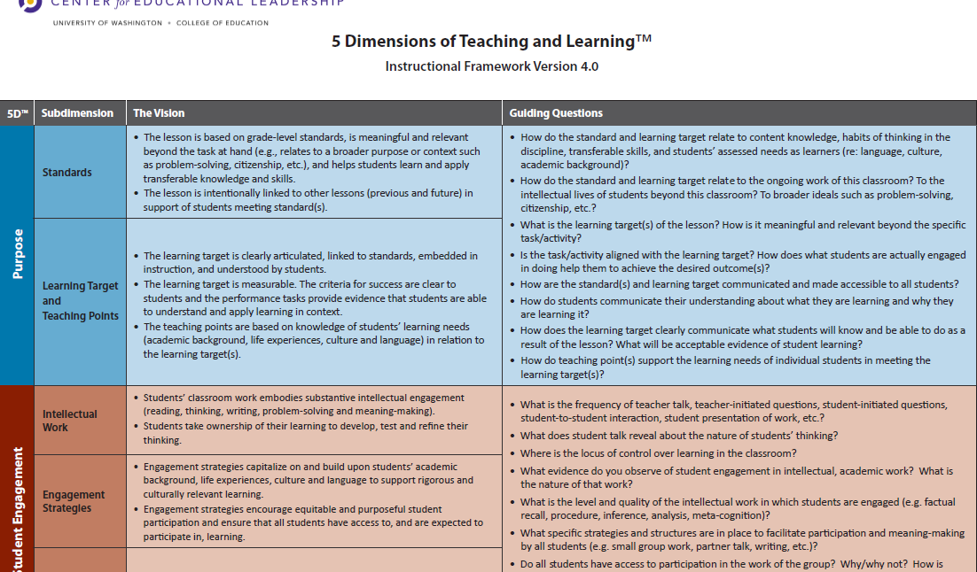
The 5D Instructional Framework as the Foundation and Support for:
Observation and analysis of teaching and learning.
Evidence-based conversations.
Collaborative, inquiry stance.
A reference during lesson planning and staff meetings about instructional practices.
Notes:
“To begin, let’s review the structure of the CEL 5D Instructional Framework.”
(READ SLIDE and then read notes below…)
“So let’s dig deeper into our Framework…
Dimensions = are listed on the left-hand side, note there are 5 Dimensions
Sub-dimensions = the sub-dimensions are to the right of the Dimensions and give you high level look fors such as standards, learning targets and teaching points
The Vision = The vision shows what each sub-dimension looks like and sounds in the ideal
The questions help guide the next steps and grow teacher practice.

Slide 10

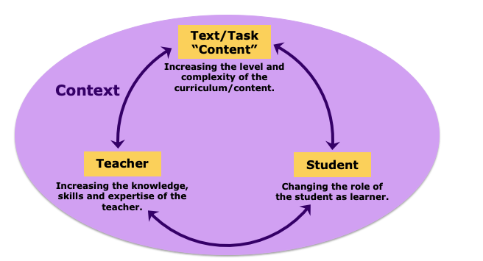
The 5D+ Teacher Evaluation Rubric is guided by a Theory of Action
Improvement of the instructional core is the key variable in student achievement.
Collaborative adult learning is the vehicle.
This is done with and through people.
The work is about the practice, NOT the person.
We are responsible and accountable to each other, and for student achievement.
Notes:
(Introduce the Rubric – new teachers have or will receive rubric and framework card from BEST)
“The rubric accompanies the Framework (the card you just reviewed) and is guided by a Theory of Action…
Improvement of the instructional core is the key variable in student achievement.
The Instructional Core =
The content and context of the lesson
Teacher knowledge and skills (Teacher actions and words)
Student as learner (Student words and actions)
Collaborative adult learning is the vehicle.
This is done with and through people.
The work is about the practice, NOT the person.
We are responsible and accountable to each other, and for student achievement.

Slide 11
The 5D+ Teacher Evaluation Rubric
Shared and common vision of high quality teaching.
Inquiry-based growth model, not a checklist.
Joins instructional leaders and teachers in co-learning.
Accessible and actionable.
Equity is embedded in each dimension.
Anchors classroom observations and continuous conversation about teaching and learning.
Notes:
“What is the purpose of the rubric? It creates a…”
1. Shared and common vision of high quality teaching.
What it looks like and sounds like
2. Inquiry-based growth model, NOT a checklist.
It’s a process, it’s NOT “What do I need to do to be Proficient?”
3. Joins instructional leaders and teachers in co-learning.
We (admin and teacher) use the rubric together as a reference to identify high quality teaching
4. Accessible and actionable
Together, we use the rubric to identify actionable next steps for high quality teaching
5. Equity is embedded in each dimension.
Fair and equal access and support for all scholars
We have a strengths-based stance with our teachers and our teachers have a strength-based stance with our scholars: Everything the child brings into the classroom is a strength
6. Anchors classroom observations and continuous conversation about teaching and learning.

Slide 12
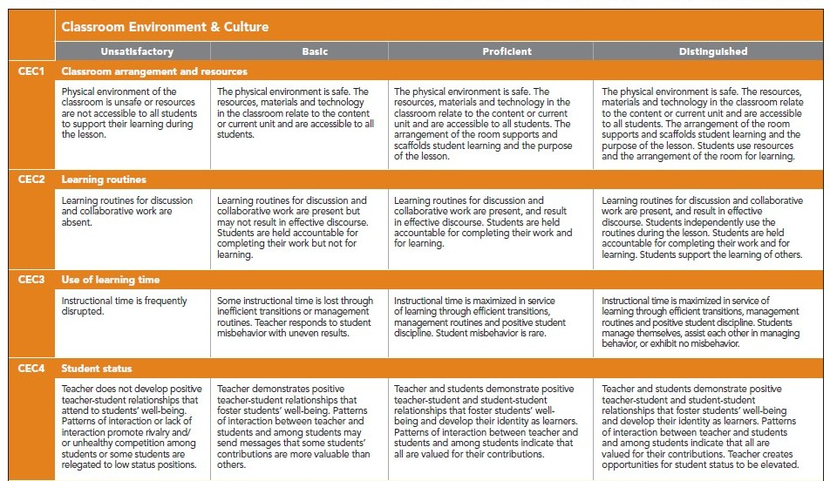
5D+ Rubric for Instructional Growth and Teacher Evaluation: Format
Classroom Environment & Culture
Dimension
Notes:
“Let’s walk through how the rubric is organized. If you happen to have a rubric with you, please open it up to the orange Dimension of Classroom Environment & Culture.”
(CLICK MOUSE to show Dimension title and DIMENSION as label)

Slide 13
5D+ Rubric for Instructional Growth and Teacher Evaluation: Format
Learning Routines
Indicator
Notes:
(CLICK MOUSE twice to show Indicator title and INDICATOR as label)

Slide 14
5D+ Rubric for Instructional Growth and Teacher Evaluation: Format
CEC 2
Indicator Number
Notes:
(CLICK MOUSE twice to show Indicator # title and INDICATOR NUMBER as label)

Slide 15
5D+ Rubric for Instructional Growth and Teacher Evaluation: Format
Unsatisfactory | Basic | Proficient | Distinguished
Performance Levels
Notes:
(CLICK MOUSE twice to show Performance Levels and PERFORMANCE LEVELS as label)

Slide 16
5D+ Rubric for Instructional Growth and Teacher Evaluation: Format
Learning routines for discussion and collaborative work are absent. | Learning routines for discussion and collaborative work are present but may not result in effective discourse. Students are held accountable for completing their work but not for learning. | Learning routines for discussion and collaborative work are present, and result in effective discourse. Students are held accountable for completing their work and for learning. | Learning routines for discussion and collaborative work are present, and result in effective discourse. Students independently use the routines during the lesson. Students are held accountable for completing their work and for learning. Students support the learning of others.
Progressive Performance Level Language
Notes:
(CLICK MOUSE twice to show Progressive Performance Levels and PERFORMANCE LEVEL LANGUAGE as labeled)

Slide 17
NEXT UP:
Learning Target You will …
Understand the inquiry cycle and evaluation process in FWPS for all comprehensive teachers.
Notes:
“Coming up next – We’ll review or learn about the inquiry cycle…” (READ LT)

Slide 18
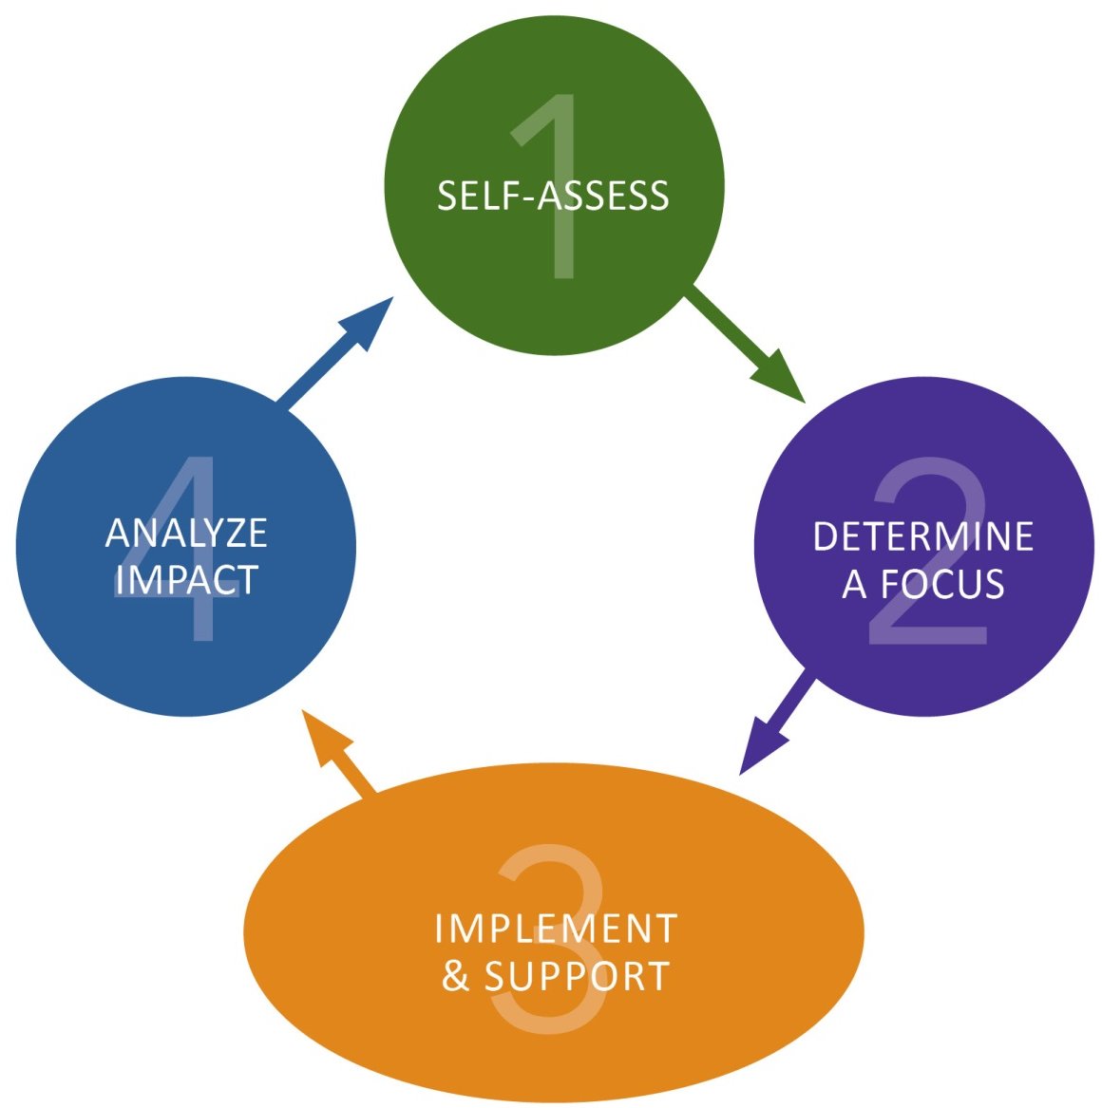
5D+ Inquiry Cycle
SELF-ASSESS:
Teacher self-assesses to identify an area of focus.
ANALYZE IMPACT:
Teacher and principal analyze the results of their work.
Based on your inquiry, what did you learn about your practice as it impacts student learning?
DETERMINE A FOCUS:
Teacher and principal analyze evidence to identify an area of focus.
Based on the responses in the self-assessment, what is your area of focus? What kind of evidence will you collect?
IMPLEMENT & SUPPPORT:
Teacher and principal engage in study and learning around area of focus.
Notes:
“Here is what the CEL 5D Inquiry Cycle looks like. There are 4 Stages.”
(Read each stage and then move to next slide)

Slide 19
Self Assessment
Notes:
“Here is the CEL 5D Inquiry Cycle per the FWEA Collective Bargaining Agreement. It reads left to right.”
(In case anyone asks: The inquiry cycle stays the same per the 2020 – 2021 negotiated agreements)
“We’re going to walk through each stage. Let’s start with your self-assessment. All staff members will complete a self-assessment using their evaluation tool. *The self-assessment is for personal use only, and staff members are not required to submit it to their evaluator (CBA, Section 5.2.D)”
(NEXT SLIDE)

Slide 20
Student Growth
Notes:
“As a part of the self-assessment, staff members also consider their growth goals for the year of their students. More time will be spent on this in later slides.”
(NEXT SLIDE)

Slide 21
Pre-Inquiry
Notes:
“We then move to the pre-inquiry conference. This is when the staff member and principal/AP determine the staff member’s area of focus.”
“The pre-inquiry conference must take place by October 31st of each school year per the CBA. It’s best to complete pre-inquiry conferences well before October 31st so that we have more time for the first inquiry cycle.”

Slide 22
1st Inquiry Cycle
Notes:
“After the pre-inquiry conference, we now move into the Fall/Winter Inquiry Cycle. The number of observations represented here IN PURPLE are the minimum required by the teacher contract for certificated staff on both the comprehensive and focus evaluation.”
“The little green PENTAGONS illustrate additional observations. There are a minimum of TWO observations in the fall and TWO in the spring – more details on this will be shared in a minute.”
“Per the CBA Section 5.2.D: At the request of the staff member, the 30-minute observation can be prearranged.
d. Within a week after each visit, evaluator will provide a coded script which may include photos, noticings, wonderings, and/or analysis/feedback.
e. The evaluator will also code all responses to wonderings submitted by the staff member
f. While not required, staff members have the right to debrief the noticings and wonderings or scripting of an observation with their evaluator.”

Slide 23
Mid-Year Formative Assessment
Notes:
“After completing the first inquiry conference, we move to the Mid-year Formative Conference. Mid-year conferences take place between the middle of January to middle of February.”
“At the mid-year conference, together we analyze the impact of the staff member and principal/AP’s work together. The staff members receives a formative assessment of their progress in growing their instructional practices – a time to celebrate and reflect upon growth made so far and to decide on whether to continue the same area of focus or identify a new area of focus for the second inquiry cycle.”

Slide 24
2nd Inquiry Cycle
Notes:
“After the mid-year formative conference, we move into the Winter/Spring Inquiry Cycle. This second inquiry cycle starts around end January/mid-February through April.”
“And, based on the formative assessment outcome of the mid-year conference, the staff member and principal or AP use the second inquiry cycle for additional opportunities to gather evidence of practice, with even more intention of growing areas where there is the greatest room for growth.”

Slide 25
End-of-Year Performance Evaluation
Notes:
“In May through the beginning of June, this is when the summative (Year-End) Evaluation conferences are held.”
“This is a time for us to celebrate the growth the staff member has made in your instructional practices over the course of the school year, to celebrate scholar growth and to preliminarily determine the focus for next school year.”

Slide 26

The Minimum # of Observations per CBA
Notes:
“The purpose of this slide is to review of the minimum number of observations per the CBA for both inquiry cycles.”
“The PURPLE pentagon shapes illustrate this – whether the staff member is on a comprehensive or focus evaluation, the minimum number of observations is 4.”
(NEXT SLIDE!!)

Slide 27
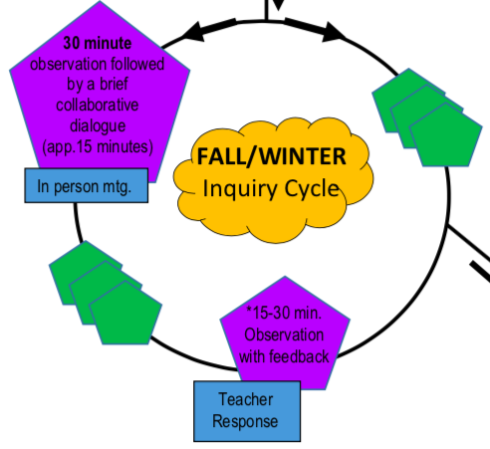
What about additional observations?
YES!
= additional observations to gather evidence of your growing instructional practice!
Notes:
“Will there be additional observations to gather evidence of practice? Yes! The little green pentagons represent additional and opportunities for us gather evidence of your growing instructional practice!”

Slide 28
Comprehensive vs. Focus
Notes:
“Here’s a quick comparison of the evaluation cycles for both comprehensive and focus.”
“The left graphic shows the COMPREHENSIVE evaluation cycle and the right-hand side shows the FOCUS evaluation cycle.”
“Both evaluations are identical with ONE exception: there must be a total of 90 minutes of observation for staff on a comprehensive evaluation. Whereas, it is a total of 75 minutes for staff on a focus evaluation.”

Slide 29
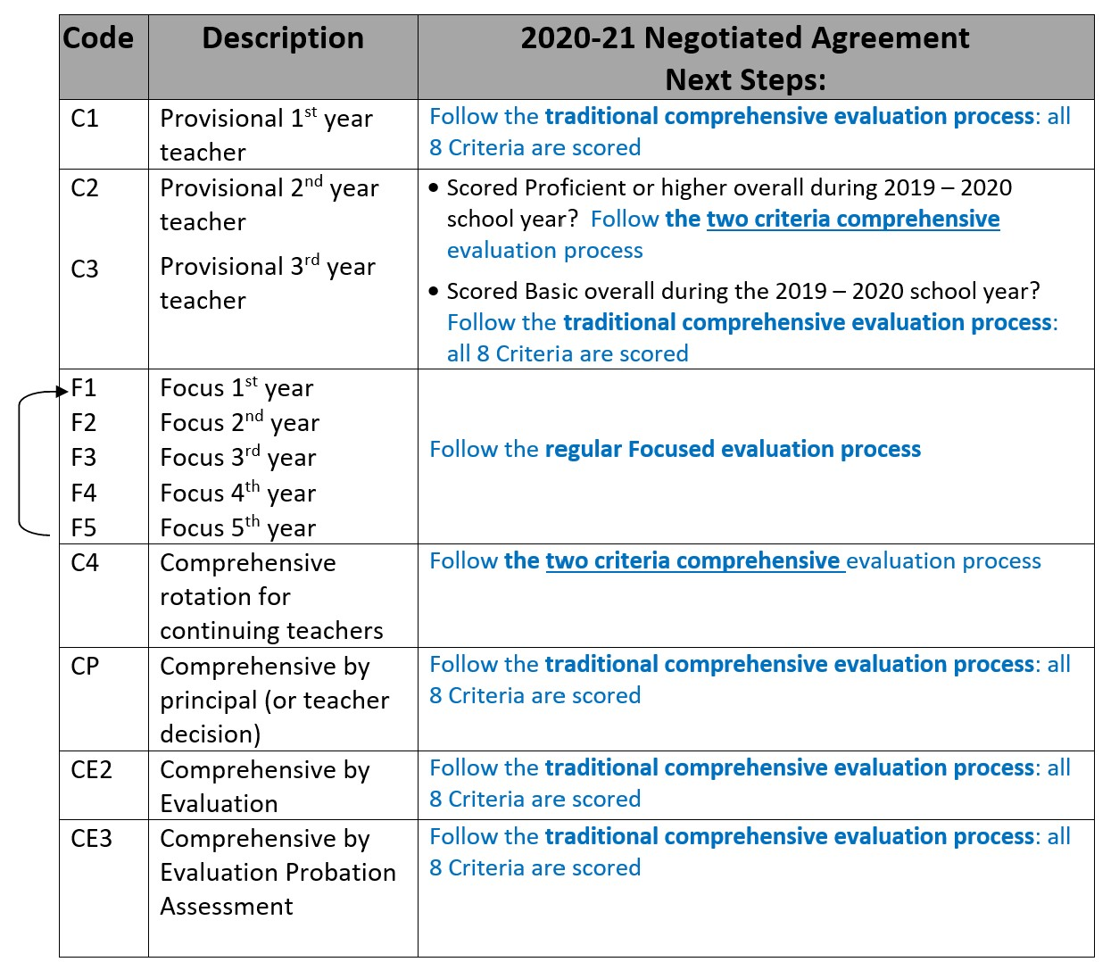
How will I know if I am on a Comprehensive or Focus Evaluation?
Notes:
(FYI: If you are not able to answer a staff member’s question, let them know that you will follow-up with a response soon, then call Alisa)
“So, how will you know if you are on a Comprehensive or Focus evaluation? At your pre-inquiry conference, you will learn from your principal or AP your evaluation rotation for this school year and what the evaluation process next steps will be for you.”
“This slide shows the evaluation rotation codes aligned to this year’s negotiated agreements, for your review. Again, when we meet for your individual pre-inquiry or goal-setting conference, we will review your evaluation type and applicable steps for this year.

Slide 30
NEXT UP:
Learning Target You will …
Learn how to complete a self-assessment and determine a preliminary focus based on your self-assessment.
Notes:
“Coming up next – We’ll learn how to complete…” (READ LT)

Slide 31
Self-Assessment: What should be included?
Self-assess your instructional practices by using the 5D+ Rubric and highlighting your present levels.
Identify school-wide instructional practice goals. Select one or two indicators to focus on together connected to our building goals.
Identify learning needs of students sitting in your classroom (complete informal assessments the first week of school).
Notes:
“Here are the steps to self-assess your instructional practices:
Complete self-assessment using the rubric and identify indicators where you see that there is greatest room for growth.
Also take into account our schoolwide SIP goals and select one or two indicators to focus on connected to our SIP goals
It’s also important to consider the learning needs of the scholars that are virtually sitting in your classroom.”

Slide 32
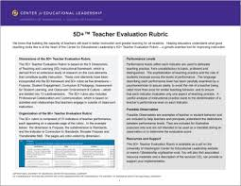

It’s time to SELF - ASSESS
Notes:
“Self-assessment means that the staff member on their own, takes a highlighter or pen and reads through each dimension. Then, marks where they believe their current practice is. This is all about growth mindset! You are marking realistically where you are on the rubric.”
(If possible, give time to complete a PRELIMINARY self-assessment of only ONE DIMENSION. FYI: Self-Assessment steps also apply to NON-CEL certificated staff with new evaluations such as Instructional Coach, LDT, librarian, etc.)

Slide 33
How do I focus on
Every.
Single.
Indicator?!
Help!
Notes:
“How DOES a staff member focus on EVERY. SINGLE. INDICATOR?!”
(NEXT SLIDE)

Slide 34
The Highest Leverage CEL Indicators
Road to Proficiency
Let’s start with…CLASSROOM ENVIRONMENT and CULTURE
ASSESSMENT
PURPOSE
STUDENT ENGAGEMENT
Consider the 3-5 indicators that will help grow your practice.
Notes:
(READ SLIDE)
(Then…CLICK MOUSE…for fly-in to show quick advertisement for Road to Proficiency courses)
“Our district offers Road to Proficiency courses, these sessions are open to all and there is a course for each Dimension. This flyer shows last years dates. The courses haven’t been scheduled yet for 2020-21, but will be soon! Teachers in their second year of teaching will attend at least 2 sessions as part of their work in the BEST program.”

Slide 35
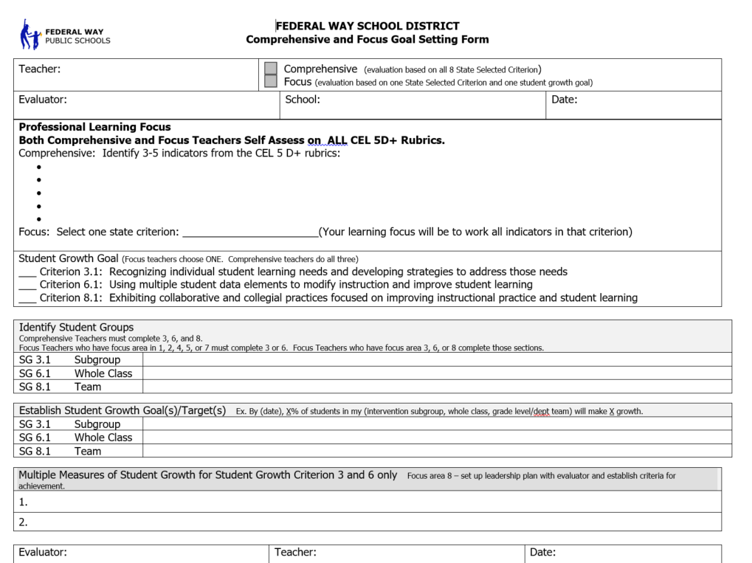
COMPREHENSIVE
Notes:
“Let’s get back to completing the self-assessment.” This is the form that staff on a CEL 5D evaluation will use to record their areas of focus. At your pre-inquiry conference, the staff member and principal or AP will meet to…”
Select select 3-5 indicators for staff who will be evaluated on a comprehensive evaluation where all 8 Criteria will be scored
OR
Select 2 Criteria for staff who will be evaluated on a comprehensive evaluation where only 2 Criteria will be scored
“This is where you will write the indicators or two criteria of focus”
(NEXT SLIDE for staff on Focus)

Slide 36

FOCUS
The most recent comprehensive overall score (Proficient or Distinguished) will be your overall score as long as you remain on a Focused evaluation.
This allows you to focus on one Criterion where there is room for growth.
Notes:
“If the staff member is on a Focused evaluation, with your principal or AP, they will select their ONE Criterion of Focus and write it in here.”
(READ YELLOW BOX – as a reminder)

Slide 37
NEXT UP:
Learning Target You will …
Student growth…
Notes:
“Now we will talk about student growth goals”

Slide 38
Establishing Student Growth Goals
Notes:
“This is where student growth goals are written on the CEL 5D goal-setting form.”
(NEXT SLIDE)

Slide 39
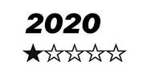
Establishing Student Growth Goals
THIS YEAR (2020 – 2021 per negotiated agreements):
ALL 8 COMPREHENSIVE = SG Goals in all 3 Criteria (3, 6, and 8)
2 CRITERIA COMPREHENSIVE =
If the 2 Criterion selected are 1, 2, 4, 5, 7 or 8, you may choose SGG 8.1
If 1 of the Criterion selected is 3 or 6, then SGG 3.1 & 3.2 OR 6.1 & 6.2
FOCUS:
If Criterion of focus is 1, 2, 4, 5, 7 or 8, you may choose Criterion 8.1
If Criterion of focus is 3 or 6, choose SGG 3.1 & 3.2 OR SGG 6.1 & 6.2
TYPICAL YEAR:
  COMPREHENSIVE = SG Goals in all 3 Criteria (3, 6, and 8)
  FOCUS =
      If Criterion of focus is 3, then SG = 3.1 & 3.2
      If Criterion of focus is 6, then SG = 6.1 & 6.2
      If Criterion of focus is 1, 2, 4, 5, or 7, then SG = 3 or 6
      If Criterion of focus is 8, then SG = 8.1
Notes:
“In a typical year, this is what it looks like for student growth goals.”
COMPREHENSIVE = The staff member works on Student Growth Goals in all 3 Criteria (3, 6, & 8)
FOCUS =
If your professional focus is Criterion 3, then student growth is 3.1 and 3.2,
If professional focus is Criterion 6, then student growth is 6.1 and 6.2
If your professional focus is Criteria 1, 2, 4, 5, or 7 then student growth is 3 or 6
If your professional focus is Criterion 8 then student growth is 8
CLICK MOUSE for fly-in!
“For the 2020 – 2021 school year, this is our agreement regarding student growth goals”
TRADITIONAL COMPREHENSIVE PROCESS:
Student Growth Goals in all 3 Criteria (3, 6, and 8)
2 CRITERIA COMPREHENSIVE PROCESS:
If the two Criterion selected are 1, 2, 4, 5, 7 or 8, you may choose SGG 8.1
If one of the Criterion selected is 3 or 6, choose SGG 3.1 and 3.2 or SGG 6.1 and 6.2
FOCUS:
If Criterion of focus is 1, 2, 4, 5, 7 or 8, you may choose Criterion 8.1
If Criterion of focus is 3 or 6, choose SGG 3.1 and 3.2 or SGG 6.1 and 6.2

Slide 40
Components of a Student Growth Goal
The goal setting process requires that we monitor and adjust our actions as needed based on information, data and feedback.
Student Growth Goals should:
  Be based on the context of the classroom & address an identified need or skill
  Be challenging for students but realistic
  Be time bound and include two points in time
  Be developed by using information and data
  Include multiple assessments or measures to monitor progress
Notes:
(REVIEW SLIDE and then…)
“Consider using a SMART goal structure as the foundation for goal setting.”
Specific and Strategic- Linked to our SIP goals (GOAL 4 Metrics). It focuses on specific student learning and answers WHO and WHAT. Strategic implies that the goal is clearly articulated and specific.
Measurable - Student success is measured by assessment. It answers the question: HOW. How will you see that change occurred? What concrete criteria will you use to measure change?
Attainable - The goal should be set high but within reason. High goals are not always attained but this does not mean it was a failure. How far will this goal stretch you? Is it too far? Is it far enough?
Results Oriented/Relevant/Rigorous: SMART goals support the SIP, tell you who has achieved proficiency, and identify which students need remediation or enrichment:
What is the evidence of our impact for our students? How will the goal increase your students’ achievement?
How do we respond if they don’t learn it? (PLC question 3)
How do we respond if they already know it? (PLC question 4)
ALSO
How will it make you a better educator?
Time Bound — All goals are bound by a clearly-defined time frame. What deadlines and milestones exist for this goal? When will this goal be completed?

Slide 41
Student Growth Rubric Language
Criterion 3 | Criterion 6 | Criterion 8
SG 3.1 Establishes appropriate student growth goals for subgroups of students not reaching full learning potential. Goals identify multiple, high-quality sources of data to monitor, adjust, and evaluate achievement of goals. | SG 6.1 Establishes appropriate student growth goals for whole classroom. Goals identify multiple, high quality sources of data to monitor, adjust, and evaluate achievement of goals. | SG 8.1 Consistently and actively collaborates with other grade-level, subject matter or district team members to establish goals, to develop and implement common, high-quality measures, and to monitor growth and achievement during the year.
SG 3.2 and 6.2 Multiple sources of growth or achievement data from at least two points in time show clear evidence of growth for most students.
Notes:
“Here is the rubric language for student grow goals.”
(READ Criterion 3.1 language)
CLICK MOUSE: “SGG 3 and 6 include ‘.2’ achievement goals.” (READ BOX)
“You will notice that the wording overall remains the same; however, the number of students changes for each Criterion”:
Criterion 3 = subgroup
Criterion 6 = whole class
Criterion 8 = team
“3.1, 6.1 and 8.1 are focused on ESTABLISHING the student growth goals. This is a mutual discussion/collaboration between teacher and principal/AP. Therefore, it’s expected that all components of the student growth goal(s) are included when these are established, so 3.1, 6.1 and 8.1 should be scored PRF.”

Slide 42
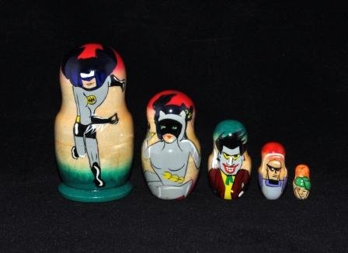
Nesting the Goals
SG 8.1
Think of the three student growth criteria as analogous to “nesting dolls,” moving from large to small
SG 6.1
SG 3.1
Notes:
“When establishing student growth goals, think of these as you would with nesting dolls, SGG 3 fits inside SGG 6 which fits inside SGG 8.1.”
“Establish ONE SGG”:
3.1 = a sub-group of students
6.1 = a class of students
8.1 = a grade level (NOTE: 8.2 does NOT exist). Staff members are not held responsible for the achievement of a grade level of students.

Slide 43
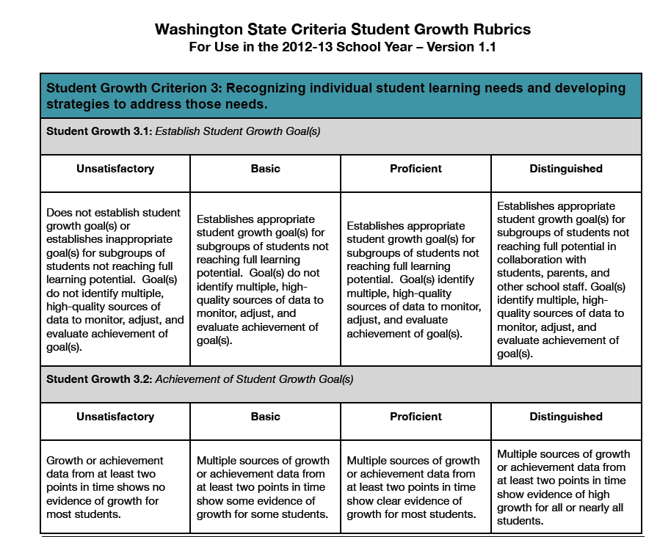
Notes:
“The rubric language is the same for all of the student growth goals. The only difference is the number of students for each SGG.”
“As an example, let’s look at the rating scale language for SGG 3.1 and 3.2. For establishing goals (.1)
PRF = goals identify multiple, high-quality…
In addition, in order to achieve DST for establishing SGG, these are to be established in collaboration with students, parents and other school staff.
“For achievement of goals (.2):
Basic - some evidence and some students
Proficient = clear evidence and most students
Distinguished = high evidence and all or nearly all students.

Slide 44
NEXT UP:
Learning Target You will …
Learn the types of evidence that can be gathered during the implement and support stage.
Notes:
“Coming up next – We’ll learn the types of evidence…” (READ LT)

Slide 45

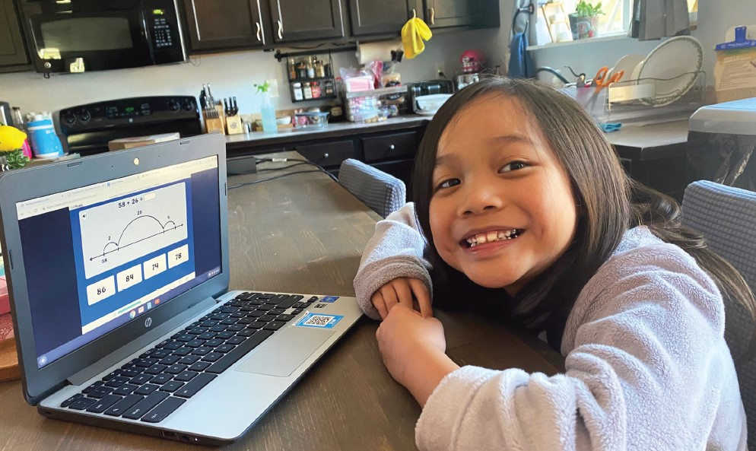
Collecting Evidence of Practice in a Remote Setting
Notes:
“Let’s talk about how evidence of your instructional practice is gathered, including in a remote setting.”

Slide 46
5D+ Inquiry Cycle – Step 3
IMPLEMENT AND SUPPORT: Teacher and principal engage in study and learning around area of focus.
  Formative and targeted feedback cycles.
  Professional collaboration (PLCs, study groups, CFGs, team planning).
  Professional development (team, building, district, individual).
Notes:
“The inquiry cycle is also called the “Implement and Support” stage. During the implement and support stage, the staff member and principal or AP are engaged in growing the staff member’s instructional practices.”
“One way this happens is through the formative and targeted feedback cycles. These cycles are mostly based on the instructional practices that happen when instruction takes place in either person-to-person or remote settings.”

Slide 47
How will my Evaluator Collect Evidence?
By scripting observations of instructional practices delivered synchronously
Conversations between teacher and evaluator
Teacher responses to wonderings
Gathering evidence of asynchronous instruction
Notes:
(READ SLIDE…)
“Evidence that is scripted will be just the facts and is descriptive”

Slide 48
What will my Supervisor do to Collect Evidence?
Collect Descriptive Data
Collect data that is:
Descriptive, not judgmental: Just the facts!
Specific: describe, count, script.
Based on the instructional core.
Notes:
(READ SLIDE)
“The more descriptive the better! This way, 2-3 months from we now, both the teacher and the principal or AP can reread the scripted evidence and remember/picture the lesson.”

Slide 49
Why Be Descriptive?
Learning to see, unlearning to judge.
Helps us to search for cause and effect relationships between what we observe teachers and students doing and what students actually know and are able to do as a consequence.
Keeps us focused on analyzing what we see going on in the classroom vs. debating what constitutes effective instruction.
City, E., Elmore, R., & Fiarman, S. (2009). Instructional Rounds in Education: A network approach to improving teaching and learning. Cambridge, MA: Harvard University Press. Chapter 4.
Notes:
(READ SLIDE)

Slide 50
Collecting Evidence During a Classroom Observation
Describing:
What are the teacher and students saying and/or doing?
What is on the walls?
How is the classroom arrangement used?
Notes:
(READ SLIDE)
“This describes part of the INSTRUCTIONAL CORE. We also collect evidence of what your students are doing in relation to the learning.”
“In addition to scripting, what other evidence is collected? (SHOW NEXT SLIDE)…

Slide 51
What is considered evidence?
Additional observations
PLC meetings
Conversations
Code responses to wonderings
Photos
Supporting documents
AND…All of this can be added to Pivot!
Notes:
(READ SLIDE)

Slide 52
Factual and Descriptive Scripts
What else is Considered Evidence?
CBA: 5.2. E. Final Evidence is Based on Evidence Gathered During the Inquiry Cycles – Evidence is mainly collected during observations as recorded in the evaluator scripts. Observations shall mean “the gathering of evidence made through classroom or worksite visits, or other visits, work samples, or conversations” between the educator and evaluator. In addition to observed practices, evidence may also be gathered through answers to wonderings, artifacts, and student growth data. (if applicable). Prior to completing summative evaluation, the evaluator will discuss how all evidence was considered in determining the summative evaluation.
Notes:
“Here is what the CBA says about evidence and this language is aligned to the WAC.”
(READ CBA language)
Coded scripts
Photos
Supporting documents related to observed lessons
Noticings
Wonderings
Analysis/feedback
Responses to Wonderings
Conversations (between teachers and evaluators)
“So, what does evidence look like in remote instruction….?
(SHOW NEXT SLIDE)

Slide 53

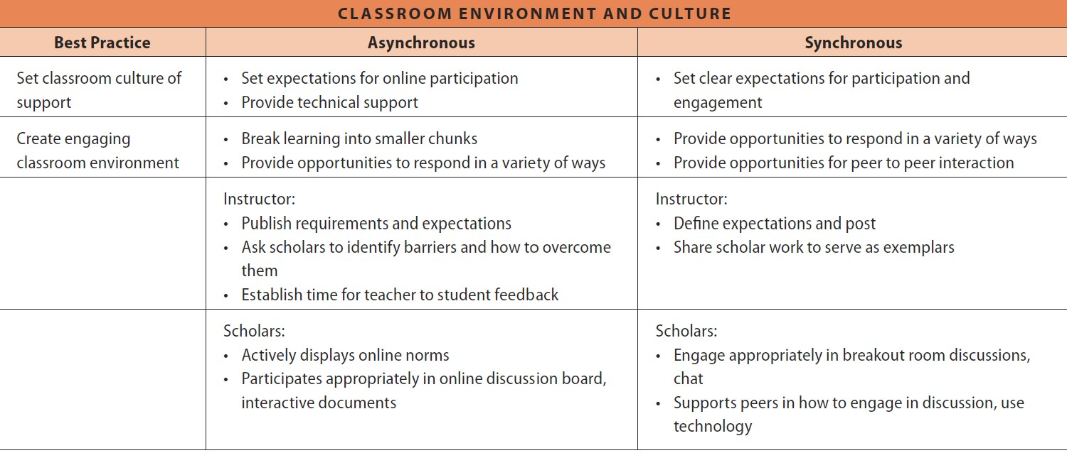
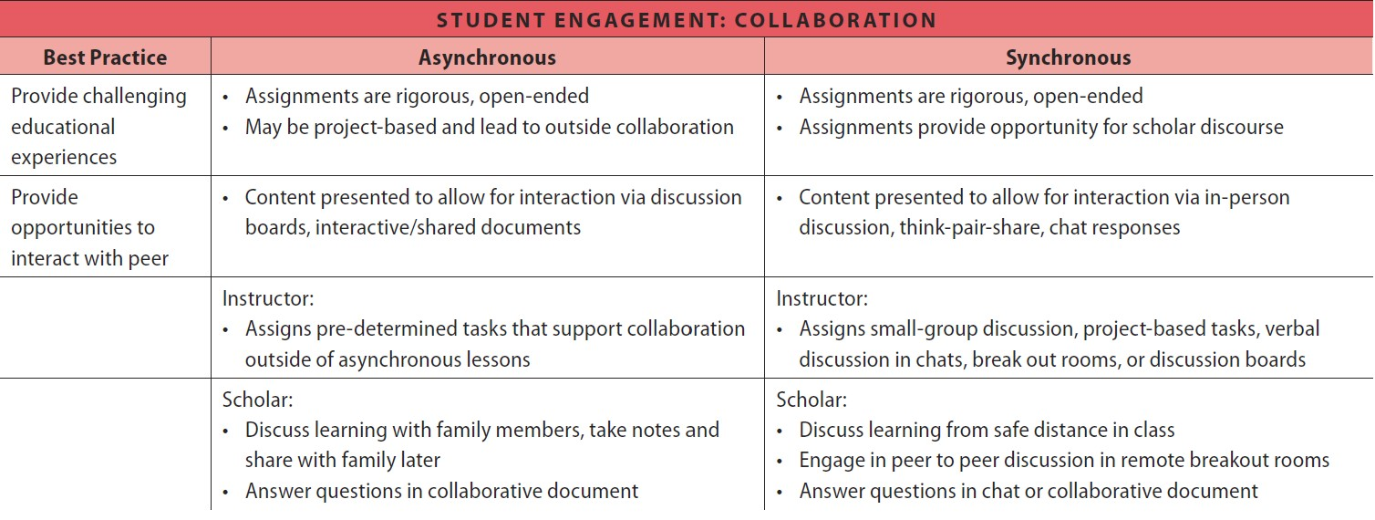
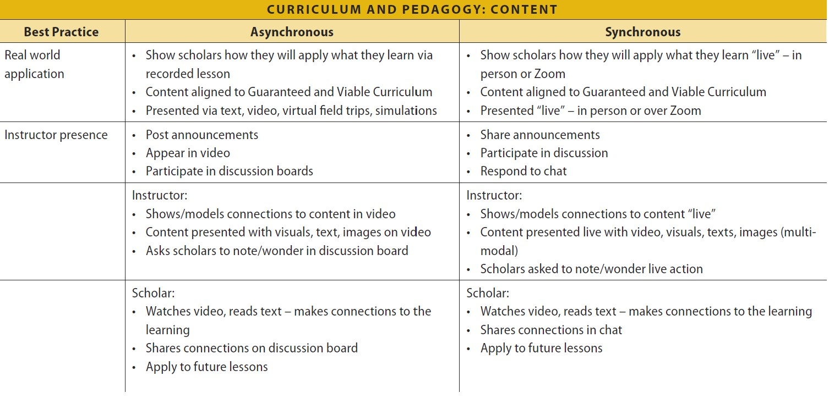
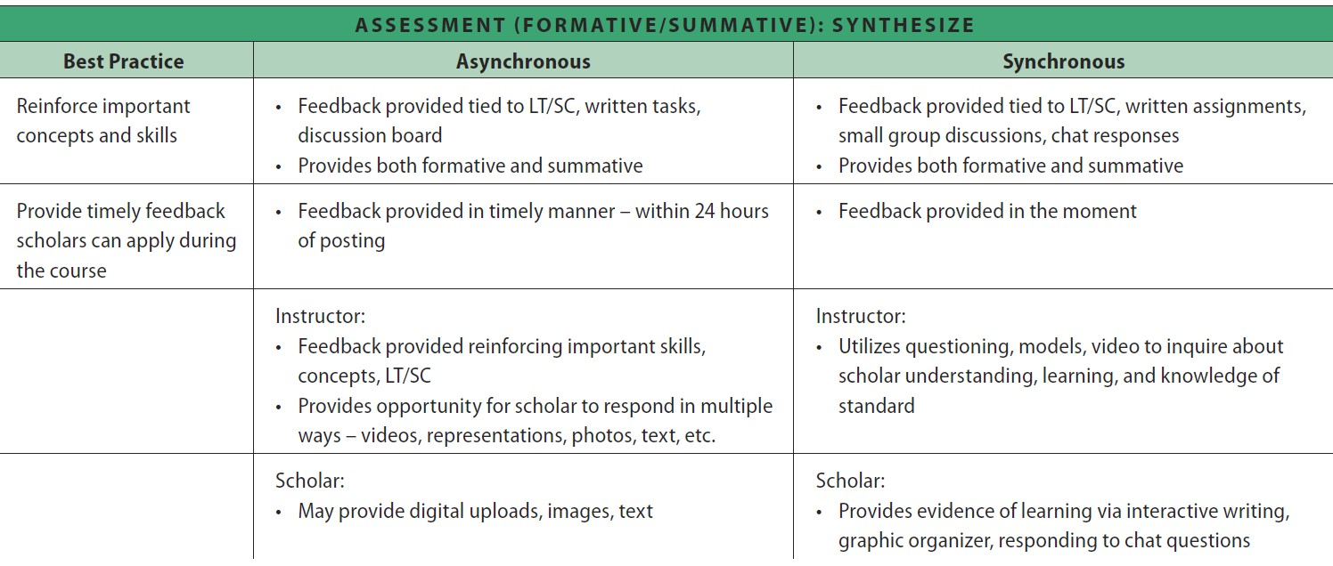
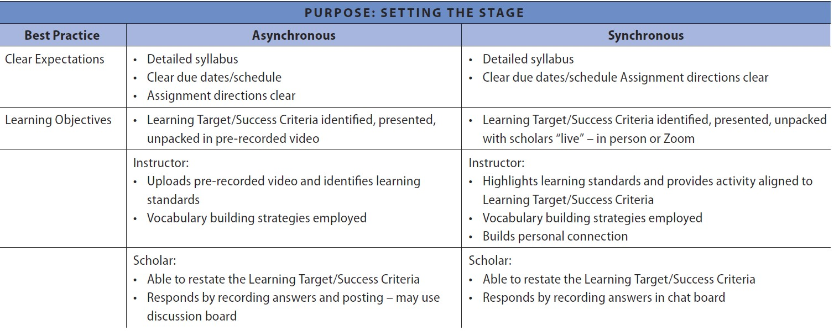
Online Instruction aligned to Best Practices and CEL 5D
Notes:
“Throughout the Continuous Learning Guidebook, online instruction is aligned to the CEL 5D Instructional Framework. Here are examples of teacher and scholar actions aligned to CEL in both asynchronous and synchronous delivery”
PURPOSE: Clear expectations are communicated using Canvas and Zoom. Learning targets are still present, communicated and unpacked
(CLICK MOUSE for fly-in of next Dimension)
STUDENT ENGAGEMENT: Instruction allows for interaction via discussions, chat box responses and possibly break-out rooms. Beyond student responses, note that assignments provide opportunities for discourse and are project-based
(CLICK MOUSE for fly-in of next Dimension)
CURRICULUM & PEDAGOGY: Instruction is aligned to the GVC and visuals are provided. teacher models connections to learning
(CLICK MOUSE for fly-in of next Dimension)
ASSESSMENT: Teacher provides feedback that’s connected to the learning target and success criterion
(CLICK MOUSE for fly-in of next Dimension)
CLASSROOM ENVIRONMENT & CULTURE: Teacher co-creates norms with scholars for participation and engagement

Slide 54
Just so you know…
Noticings are based on ANY indicators
Wonderings are based on your focus indicators only
Feedback guides your next steps to grow your instructional practice. Feedback is aligned to focus indicators.
Notes:
“What happens after scripted evidence is collected? The principal or AP will review the evidence, code CEL 5D indicators where evidence is aligned and then provide noticings that could be aligned to the teacher’s indicators of focus or could be aligned to any indicator in the rubric.”
“Also, the principal or AP may include wonderings. What are wonderings? Wonderings are authentic questions that your principal or AP might ask to help them better understand your instructional moves of the lesson.”
“Often, the principal or AP will provide you “bite-sized” pieces of feedback based on what you are able to do. The feedback will help you grow your practice. It’s important to apply the feedback to your instruction. If you are unclear, don’t hesitate to ask!”

Slide 55
NEXT UP:
High level overview of analyzing the impact of your work: Mid-year and End-of-year
Notes:
“Coming up next – We’ll review a high level overview of analyzing the impact of your work…”

Slide 56
Notes:
“As a recap from earlier slides (slides 23 and 25), we ANALYZE THE IMPACT twice a year.”
“The Mid-year happens in January or February. It’s a time to do a ‘temperature check’ and to analyze if adjustments should be made based on growth or lack of growth of instructional practices.”
“The summative/year-end evaluation takes place in May, or by the latest, the first Friday in June (per CBA). This is a time to celebrate the growth that has taken place over the course of the school year and also to determine next steps for the following school year.”

Slide 57
Where are observations and evaluations completed?
PIVOT
Notes:
“Observations and evaluations are completed an stored in the online platform called PIVOT.”

Slide 58
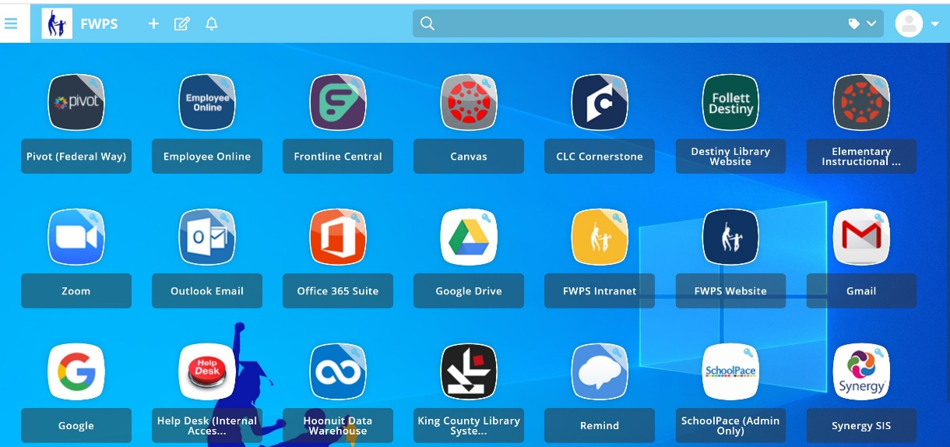
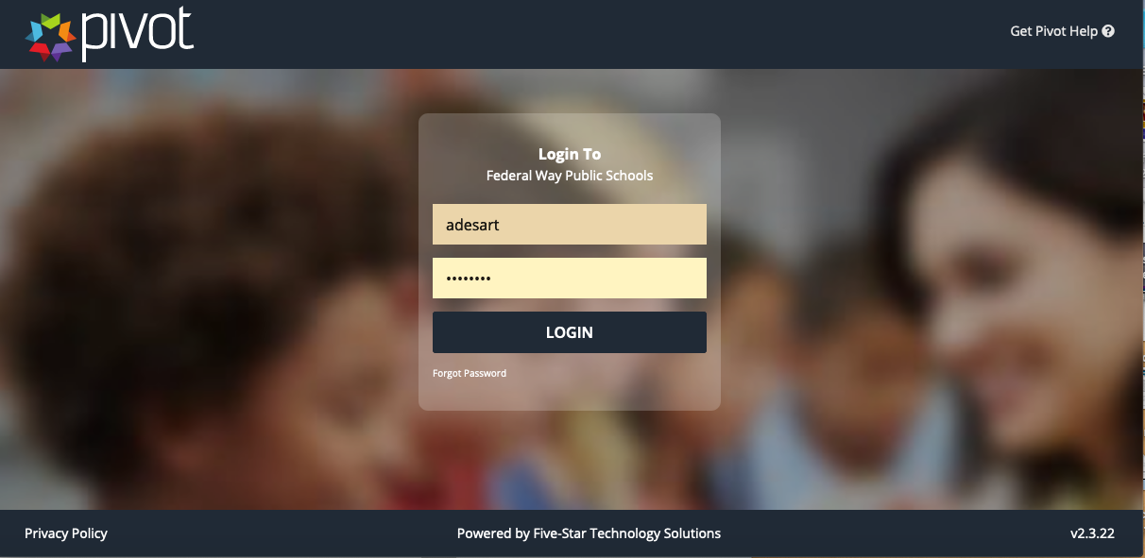
Accessing Pivot
STEP 1: Go to the FWPS Portal, LaunchPad to Learning
STEP 2: You may need to log-in to Pivot also (use your username & password)
Notes:
“To access Pivot…”
(READ SLIDE)

Slide 59
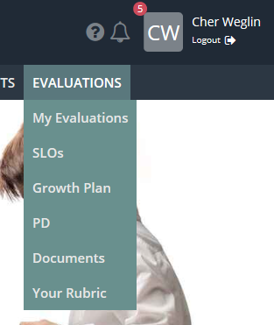
How to Log in to PIVOT to Review Your Observation
Select Evaluations Tab
Here is where you will see your observations and evaluations that have been completed
Select “View” under My Observations section to view your observation
Notes:
(READ SLIDE)

Slide 60
“Where students are concerned, the teacher will always be more powerful than the principal, the president, or the prime minister. Successful and sustainable improvement can therefore never be done to or even for teachers. It can only ever be achieved by and with them.”
– Andy Hargreaves and Michael Fullan
Hargreaves, A. and Fullan, M. (2012) Professional capital: Transforming teaching in every school. New York City: Teachers College Press. p. 45.
THANK YOU!
Notes:
(LAST SLIDE)
(Thank them for their time and one of the presenters or a volunteer reads quote aloud to end)

