Slide 1
Welcome to our April 10 minute FWEA meeting

Slide 2
BAT Team Update:
Our BAT Team needs to verify the CONTACT INFORMATION of ALL MEMBERS
IMPORTANT Bargaining information and updates will continue to be shared through our BAT Phone tree!
Please see your Building BAT Team Leads/Helpers to make sure your contact information is correct!

Slide 3
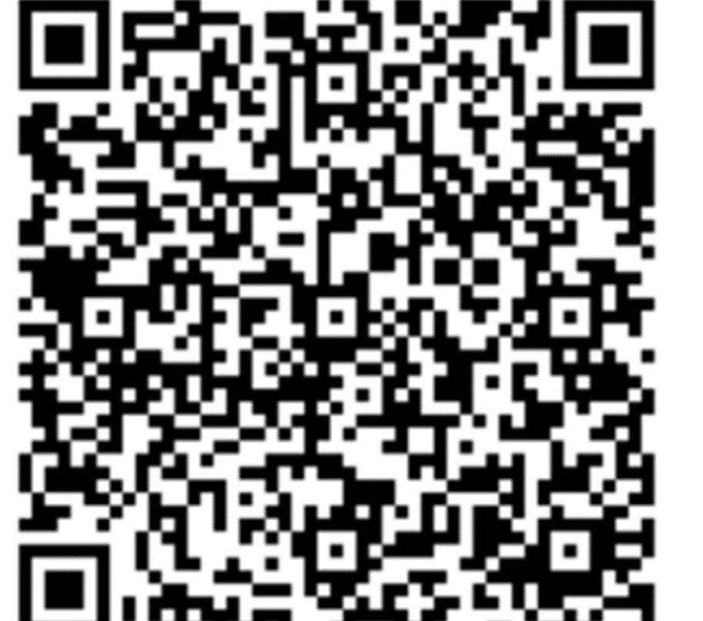
Support our Bargaining Team
We still need groups/schools to sign up to support our bargaining team!
Special shout out to Valhalla and Lakota who covered our first two bargaining sessions!
THANK YOU to Adelaide, Olympic View, Kilo, Wildwood, Decatur and Sacajawea for signing up for future dates!

Slide 4
AR Election Process
AR elections are held annually in the spring
ALL members are eligible to serve as Association Representatives (ARs)
ESPs should be included in the notification of the election process!

Slide 5
AR Responsibilities
ARs attend our monthly Association Representative (AR) meetings (September-June)
Invite and welcome new colleagues into FWEA membership
Conduct monthly 10-minute FWEA meetings at your site. (FWEA provides a powerpoint for this meeting!)
Loop in ESPs if they are unable to attend 10 minute meetings
Support the Building Action Team BAT) structure with two-way communication to all members
Create an email list for members at your worksite
Forward ALL information from FWEA to your members

Slide 6
AR Responsibilities (continued)
Represent members in meetings/matters where disciplinary action might be involved (the AR takes confidential notes during the meeting to support the member)
Hold Association Representative elections in the Spring
Be familiar with the collective bargaining agreement for ESPs, Athletic Coaches, and certificated FWEA members
Reach out to other ARs, the FWEA Executive Board or FWEA Advocacy Team for support in addressing/resolving issues
Meet monthly as the AR team with principal (aka “check-ins). This is to proactively address, and problem solve issues as they arise
Support, facilitate and/or lead the consensus process for shared decision making in the building as outlined in the CBA

Slide 7
Characteristics of an AR
Confidentiality! Is and must be your first priority as a representative. You are representing fellow colleagues or our collectively bargained agreement. You are there as a representative of the 1700 members of FWEA.
Good representation for all levels/areas of the building
Well respected by staff at the site
Have the ability and willingness to express the opinions of staff in a respectful, honest manner
Centers racial and social justice in our roles as union members
Ability to listen to members and have a pulse on the building
Able to communicate well with other regardless of differing opinions
Able to follow-through on tasks

Slide 8
Feedback from current ARs
We asked current ARs to share about their experiences at our last meeting on April 29th
Here are some snippets of why they enjoy being an AR for FWEA:
Advocating for all members
I enoy talking with all the members in our building. I like being able to problem solve issues that come up
Getting to build power between buildings, empower and support colleagues
Getting to represent the voice of our building’s members, and being able to learn more about our CBA and right as educators in FWEA.
I also love the opportunity to get to meet and connect with ARs across the district, in all different levels and roles. It truly has been an amazing learning experience, as well as a powerful way to build solidarity

Slide 9
Does this sound like you?
See a current AR to learn more about the election process, or if you would like to run to represent your school!

Slide 10
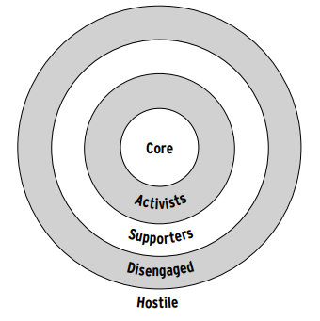
Secrets of a Successful Organizer Training
Turning supporters and activists into union organizers
Identify and beat “apathy”
Power mapping schools
Turn an issue into a campaign
Strengthen our union as we bargain
Notes:
Isabelle Tetu will present this slide and share a little about her experience with the Labor Notes Conference

Slide 11
Interested in bringing this to our building and Learning More?
Notes:
Isabelle still…

Slide 12
NEA-RA Election Results
Please join us in congratulating our elected delegates for the 2024 NEA-RA:
James Brown
Shannon McCann
Jeremy Bort
Steve Mayer
Brad Plemons
Olivia Coley-Bishop
Sav Bair
Isabelle Tetu
Ashley Hoffman
Stephanie Price

Slide 13
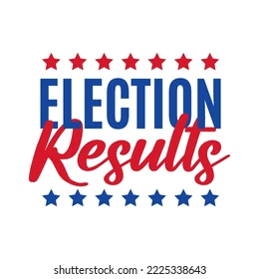
Executive Board Election Results
President: James Brown
Vice President: Emily Wilson
Secretary: Yuri Mobley
Elementary Rep (2 yr term): Gina Harada
Elementary Rep (1 yr term): Olivia Coley-Bishop
Ethnic Minority Rep: Stephanie Price
High School Rep: Erik Grotzke
ESP: Sara Rowe

Slide 14
Upcoming Events
LGBTQIA+ Joy and Resiliency Event: May 15th
FWEA Trivia Night: May 16th
School Board Meetings:
Tuesday May 14, TAF @ Saghalie
Tuesday May 28, Star Lake Elementary
Tuesday June 11, Panther Lake Elementary
Pre-Retirement Seminar: May 10-11th

