Slide 1
Welcome to our May 10 minute FWEA meeting

Slide 2
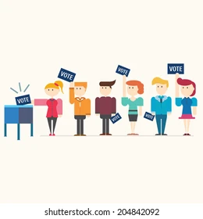
AR Election Process
AR elections are held annually in the spring
ALL members are eligible to serve as Association Representatives (ARs)
ESPs should be included in the notification of the election process!
If you are interested, see a building AR
Election results are due to FWEA by MAY 28th

Slide 3
Why become an AR?
Current ARs enjoy:
Advocating for all members
I enjoy talking with all the members in our building. I like being able to problem solve issues that come up
Getting to build power between buildings, empower and support colleagues
Getting to represent the voice of our building’s members and being able to learn more about our CBA and right as educators in FWEA.
I also love the opportunity to get to meet and connect with ARs across the district, in all different levels and roles. It truly has been an amazing learning experience, as well as a powerful way to build solidarity

Slide 4
Reminder: Bargaining update and Dates…
May 22nd (WEAR RED and sign the solidarity banner)
May 28th
May 31st
June 4th (we WEAR RED on our walk-in date)
June 17th (new date added!)
June 18th (new date added!)
June 20th (new date added!)
June 21st (new date added!)

Slide 5
Are YOU solidarity ready?
We have three questions for you!
Please see an AR to answer these questions and to sign our solidarity banner!
We are having district wide walk-ins between June 4th-June 7th
Our site’s walk-in is: ______________________

Slide 6
And now for an important announcement!
MARK YOUR CALENDARS!!
We are pleased to announce an IN-PERSON General Membership Meeting (GMM)
Tuesday August 27th at Thomas Jefferson High School after your 4+1 day.

Slide 7
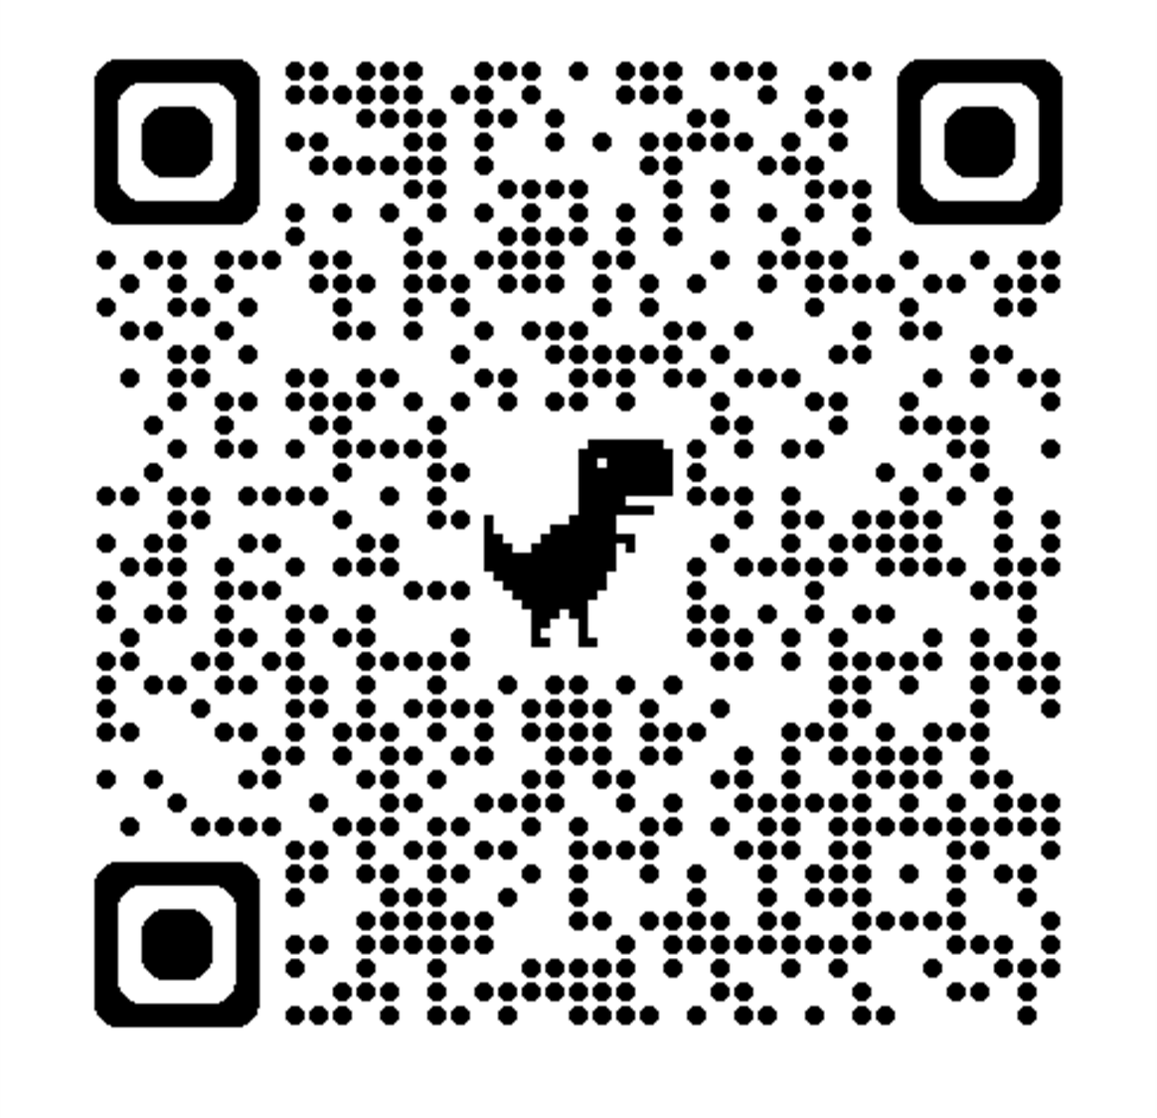
Upcoming Events
FWEA Board Watch (scan QR to sign up):
Tuesday May 28, Star Lake Elementary
Tuesday June 11, Panther Lake Elementary
FWEA Walk-in Week: June 3-7

